Slide 1
CSE 5324: SOFTWARE ENGINEERING: ANALYSIS, DESIGN, AND TESTING UTA ACCOMMODATION FINDER: EASY WAY FOR PEOPLE TO SEARCH FOR RENTAL HOMES PROJECT GROUP 1: THE PARALLAX PROGRAMMERS
TEAM MEMBERS:
SAI ROHITH PASALA
SREE HARSHA KANDEPANENI
LIKITH REDDY VATTIGUNTA
MANIDEEP REDDY KARRA
ANAMIKA REDDY KAROLLA
INSTRUCTOR
DR.MICHAEL F. SIOK, PE, ESEP

Slide 2

AGENDA
PROJECT DESCRIPTION
PROJECT REQUIREMENTS
USE CASES
HIGH LEVEL USE CASES
USE CASE DIAGRAM
REQUIREMENT TO USE CASE MATRIX
INCREMENT MATRIX
DOMAIN DIAGRAM
TASK LIST
PRESENTATION SUMMARY

Slide 3
PROJECT DESCRIPTION
The main aim of this application is to help current and prospective student/staff of university to find the best available housing/accommodation options on and off campus near the university.
This app is a rental-based application which provides owners of the house to post the availability and allows the student/staff, who are searching for a place, to browse through the different housing options.
This app also helps international students to ease their way in finding accommodation and gather all the options before entering the country itself.

Slide 4
PROJECT REQUIREMENTS
Req ID | Requirement Statement | Line Reference
R1 | The system shall provide a form with the fields UTA ID, Name, Mav ID, phone number , password, confirm password, course, start semester, preferences which will include room preference for the new user to sign up. | 14, 15-17
R2 | The system shall provide the authenticated user to login to the app. | 14, 15-17
R3 | The system shall provide the user to either post a listing or search flats. | 27, 28-31
R4 | The lessor shall provide the user to post the details of the house by giving the mandatory information like Apartment Description, Rent, Phone Number, Email ID, and Type of Room | 27, 31-34
R5 | The system shall allow the user to view their post listing | 19,21
R6 | The system shall allow lessor to modify listing | 19, 22
R7 | The system shall allow the lessor to delete the listing | 19, 23
R8 | The system shall allow the user to choose between furnished or unfurnished options | 27, 31-34
R9 | The system shall allow the authenticated user to reset his current password | 36-37, 39- 41
R10 | The system shall allow the user to mark their favorite listing and view it on the favorites page | 27, 33-34
R11 | The system shall allow the authenticated user to logout from the application | 46, 47-48
R12 | The system shall provide the user to reset their forgotten password | 36-37, 42- 44

Slide 5
USE CASES
Use Case # | Use Case Name
UCI | Sign Up
UC2 | Login
UC3 | Post Listing
UC3.l | Modify Listing
UC3.2 | Delete Listing
UC4 | Search Flat
UC4.l | Explore Furnished Apartments
UC4.2 | Explore Unfurnished Apartments
UC5 | Reset Password
UC6 | Log out
UC7 | Forgot Password

Slide 6
HIGH LEVEL USE CASES
TUCBW - The Use Case begins with…
TUCEW - The Use Case ends with…
UC 1: Sign Up
TUCBW the user being able to create an account by giving all the mandatory details.
TUCEW the user creating an account.
UC 2: Login
TUCBW the user entering his login credentials and clicking on login button.
TUCEW the user logging into the app.
UC 3: Post Listing
TUCBW the lease holder clicking on "Post Listing" button on the homepage which will direct him to a new page.
TUCEW the lease holder providing all the details related to the house and the listing is posted on the app.
UC 3.1: Modify listing
TUCBW the lease holder clicking on modify listing button and modifies any of the given details and clicks on submit.
TUCEW the listing getting modified and the changes will be reflected on the app.
UC 3.2: Delete Listing
TUCBW the lease holder clicking on delete listing button when it is no longer required.
TUCEW the list getting deleted from the app.
UC 4: Search Flat
TUCBW the user clicking on Search flat button on the homepage.
TUCEW the user being directed to another page where they have options to choose between Furnished apartments and Unfurnished apartments.
UC 4.1: Explore Furnished Apartments
TUCBW the user clicking on the preferred furnishing option.
TUCEW the user being able to browse through all the available furnished housing options and make favorites as well.
UC 4.2: Explore Unfurnished Apartments
TUCBW the user clicking on the preferred unfurnished option.
TUCEW the user being able to browse through all the available unfurnished housing options and make favorites as well.
UC 5: Reset Password
TUCBW the user clicking on Reset password button and will be able to reset their password giving the current password.
TUCEW the password getting reset.
UC 6: Logout
TUCBW the user clicking on Logout button to exit from the app.
TUCEW the user exiting from the app and will be directed to the login page.
UC 7: Forgot Password
TUCBW the user clicking on the forgot password button on the login screen and will give the registered email id.
TUCEW the user being able to reset the forgotten password from the link sent to their email ID

Slide 7
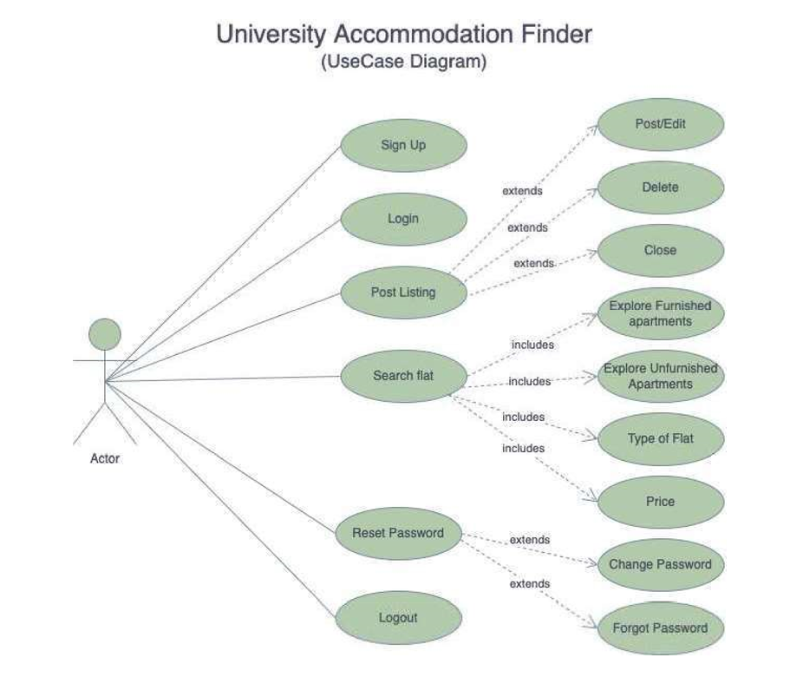
USE CASE DIAGRAM

Slide 8
REQUIREMENT TO USE CASE TRACEABILITY MATRIX
Req ID | Priority Weight | UC1 | UC2 | UC3 | UC4.1 | UC4.2 | UC5 | UC6 | UC7
R1 | 1 | *
R2 | 1 |  | *
R3 | 2 |  |  | *
R4 | 2 |  |  | *
R5 | 3 |  |  | *
R6 | 4
R7 | 4
R8 | 2 |  |  |  | * | *
R9 | 2 |  |  |  |  |  | *
R10 | 2 |  |  | *
R11 | 5 |  |  |  |  |  |  | *
R12 | 3 |  |  |  |  |  |  |  | *
 | Score | 1 | 1 | 12 | 2 | 2 | 2 | 2 | 3
Note: Priority 1 is the weighted priority.

Slide 9

INCREMENT MATRIX
Use Case # | Priority | Effort | Depends on | Iteration 1 | Iteration2 | Iteration 3
 |  | Person Weeks) |  | 3/02/2022 | 4/04/2022 | 5/02/2022
UC1 | 1 | 3 | None | 3
UC2 | 1 | 3 | None | 3
UC3 | 2 | 7 | UC1 and UC2 |  | 4 | 3
UC4 | 2 | 2 | UC1 and UC2 |  | 1 | 1
UC4.1 | 3 | 3 | UC4 |  | 2 | 1
UC4.2 | 3 | 3 | UC4 |  | 2 | 1
UC5 | 5 | 1 | UC1 and UC2 |  |  | 1
UC6 | 3 | 1 | UC1 and UC2 |  | 1
UC7 | 6 | 1 | UC1 and UC2 |  |  | 1
Total Effort |  | 24 |  | 6 | 10 | 8
1 PW= 5 |  |  |  | 30 | 50 | 40

Slide 10
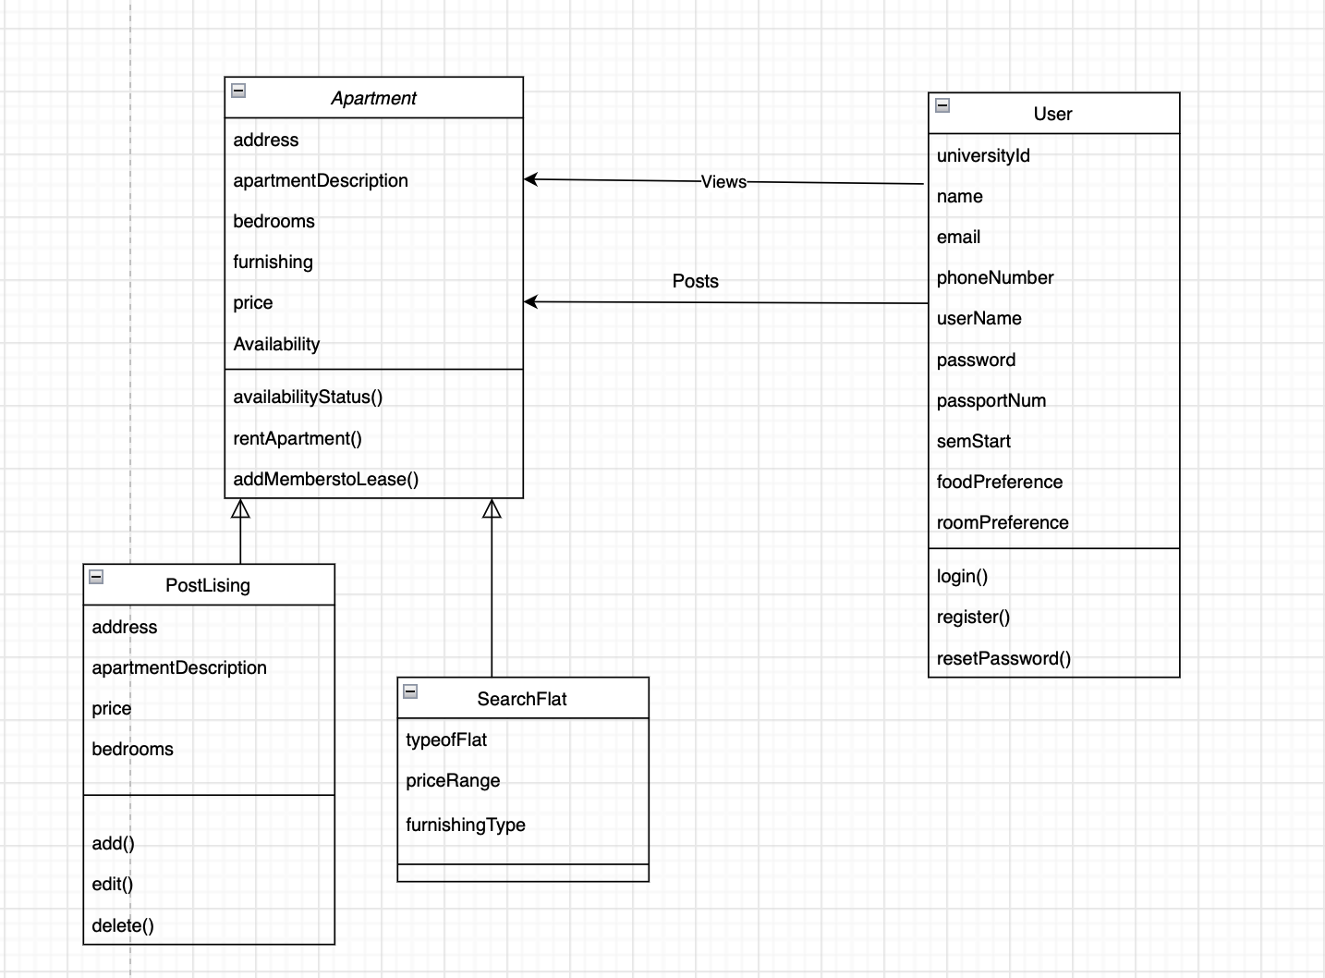
DOMAIN DIAGRAM

Slide 11
TASK LIST
Use Cases | Use case Name | Team Member Assigned | Iteration (Due by)
UC1 | SignUp | Rohith | 1
UC2 | Login | Rohith | 1
UC3 | Post Listing | Harsha | 3
UC4 | Search Flat | Anamika | 3
UC4.1 | Explore Furnished Apartments | Manideep | 3
UC4.2 | Explore Unfurnished Apartments | Manideep | 3
UC5 | Reset Password | Likith | 2
UC6 | Logout | Anamika | 2
UC7 | Forgot Password | Likith | 2

Slide 12
PRESENTATION SUMMARY
In conclusion, we reviewed the primary needs, available functions, and the structure of the application.
Result or Take-aways:
One stop solution for students to search all housing options on/off campus.
Students can filter housing options based on their preference.
Hassle free communication between students and lease holder.
Students can get clear understanding of the flat.
Simple and efficient way of posting the availability of the flat.

Slide 13

THANK YOU

